Slide 1
Show Table of Contents
FY2027 All Capital Requests
Marblehead 10-Year Financial Plan
2025 Retreat Goals Status
2026-2027 Retreat Goal Setting

Slide 3
Marblehead 10-Year Financial Plan
FY2027–FY2036
Building Long-Term Financial Stability

Slide 4

Financial Strategy
Fund operations through the Tier 3 override.
1
Provide $1M annually for recurring capital (FY2027–FY2029).
2
Redirect Free Cash to Stabilization Fund toward a 5% reserve target.
3
Create a Capital Stabilization Fund to reduce future borrowing.
4

Slide 5

Timeline: FY2027–FY2029
FY2027: $15M Tier 3 Override funds operations, recurring capital, and building maintenance
$2.3M trash funding secures curbside collection through FY2031
Capital Stabilization Captures unused capital appropriations
FY2028: Continue MOU levy drawdowns with quarterly reporting.
FY2029: Final override year; deferred maintenance reduced and reserves strengthened.

Slide 6
Timeline: FY2030–FY2036
FY2030: Operations stabilized; improved ability to absorb inflation.
FY2031: Decision point—continue trash override or adopt user-fee model.
FY2032: Approximately $1M debt exclusions expire.
FY2035: Approximately $2.4M additional debt service expires.
FY2036: Pension fully funded; recommend redirecting ~65% of pension appropriation to OPEB.

Slide 7

Long-Term Benefits
Dedicated operating and capital funding.
Reduced reliance on Free Cash for annual capital articles.
Growing stabilization reserves.
Lower future borrowing needs.
Greater flexibility as debt obligations expire.
Improved long-term funding of retiree healthcare liabilities.

Slide 8
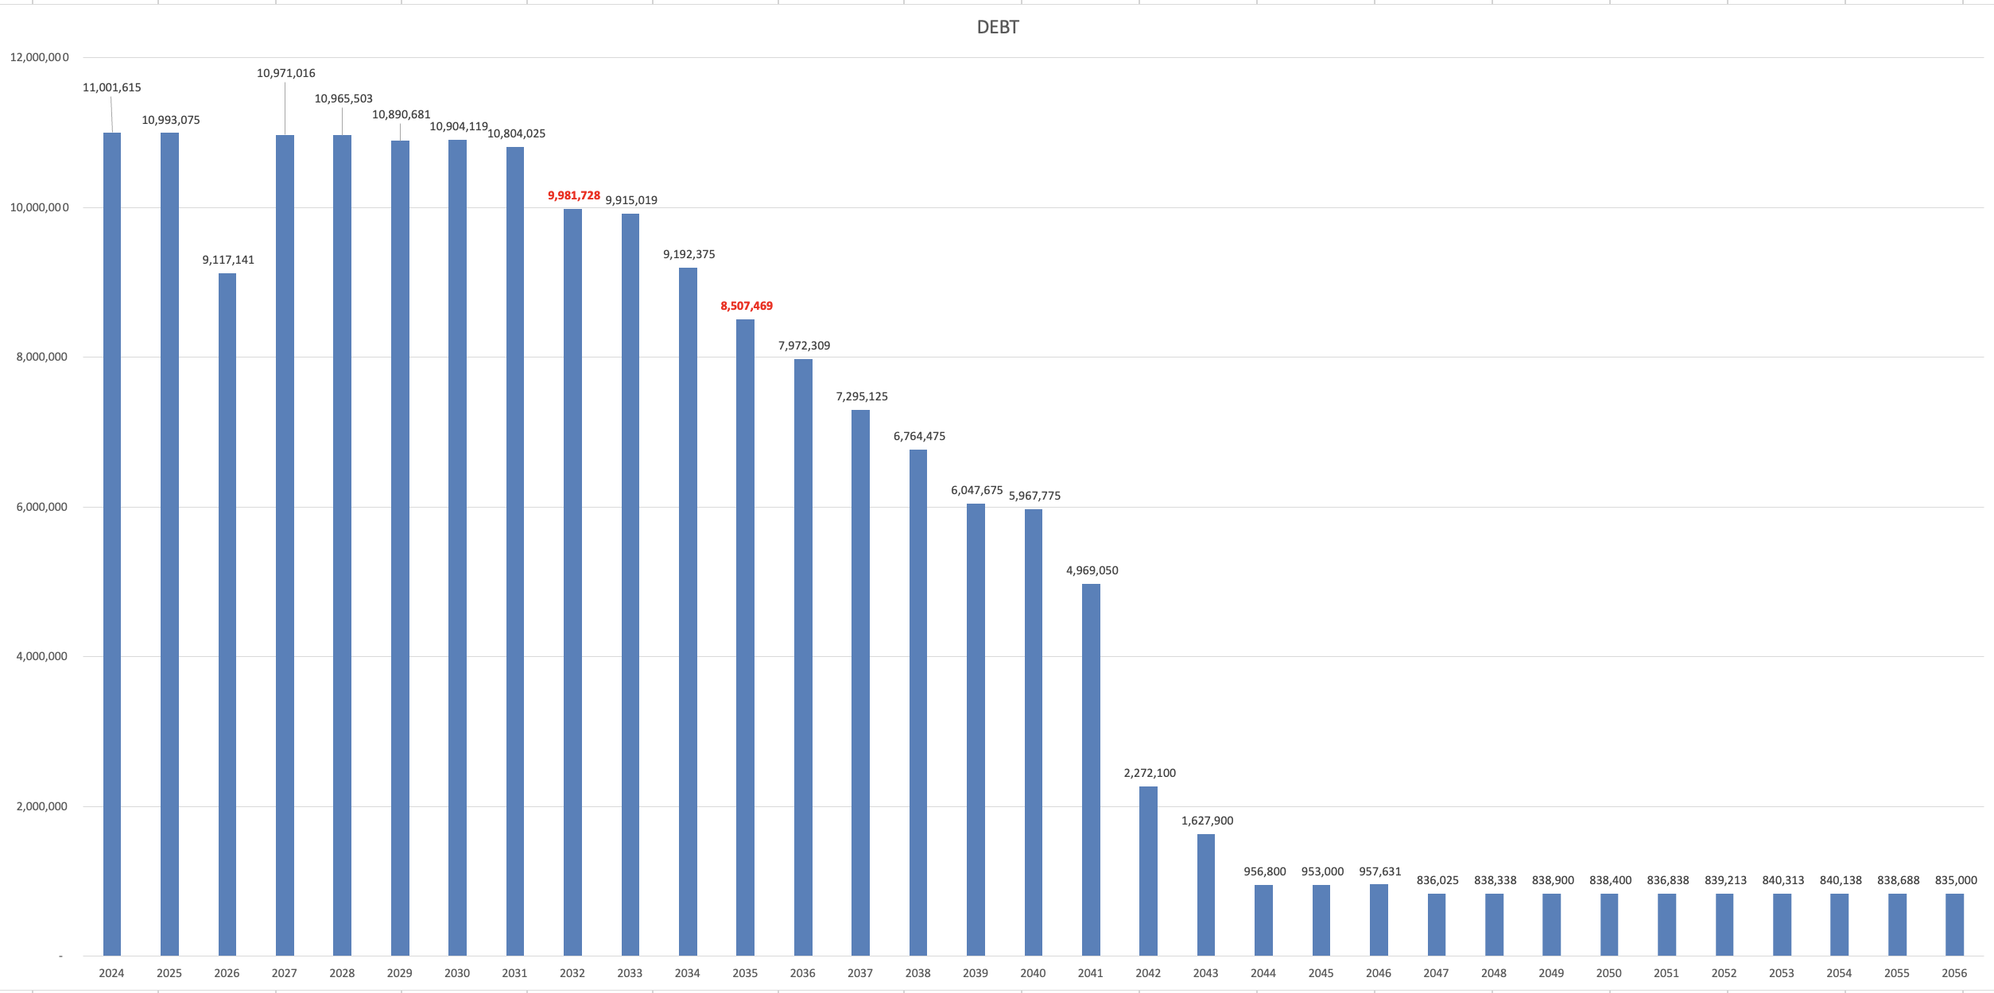

Slide 9
Key Risk & Conclusion
Plan is expected to avoid another operational override through FY2036 if annual health insurance inflation remains around or below 10%.
Sustained health insurance inflation above 10% could require additional revenue measures.
Overall strategy provides a sustainable long-term fiscal roadmap.

Slide 11
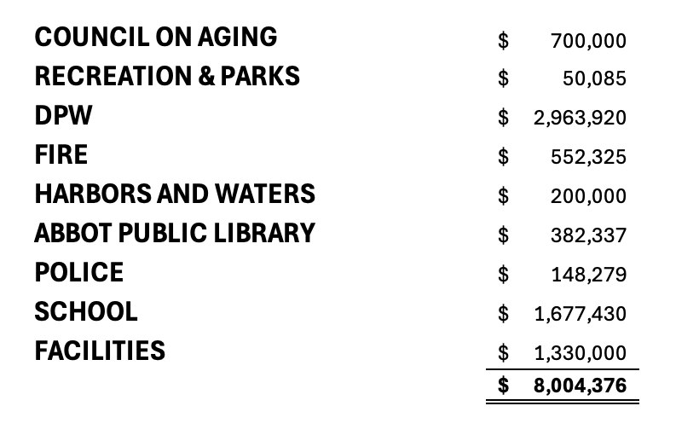
FY2027 All Capital Requests

Slide 12
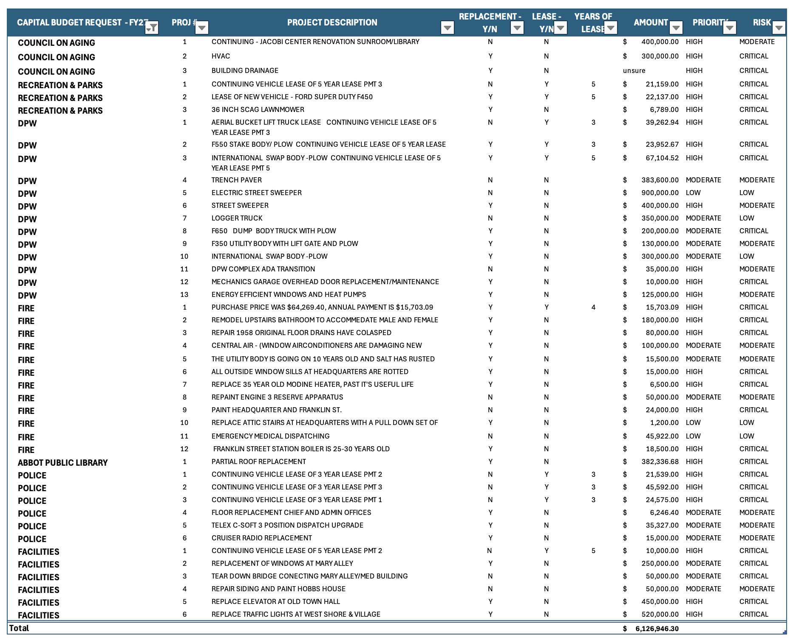

Slide 13
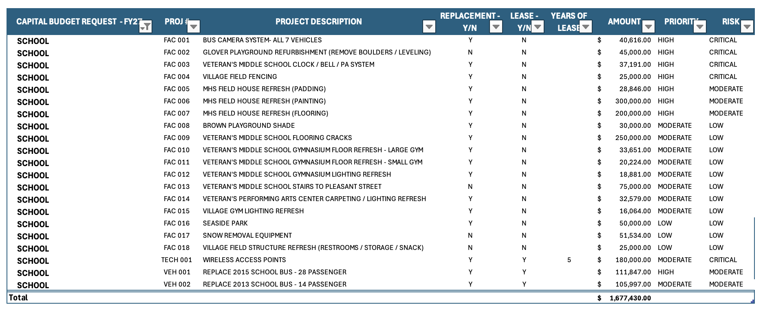

Slide 14
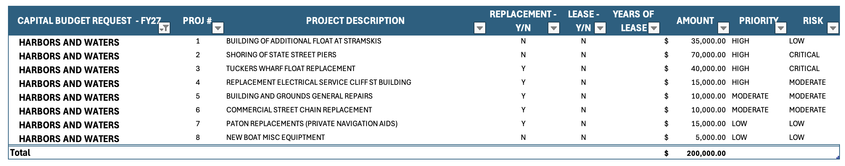

Slide 16
2025 Retreat Goals
Status Update

Slide 17
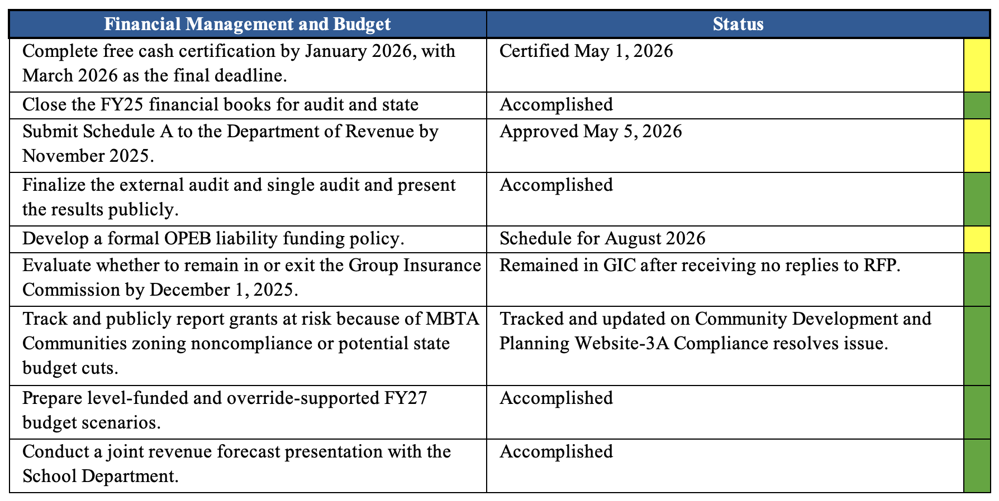
2025 Goals Status

Slide 18
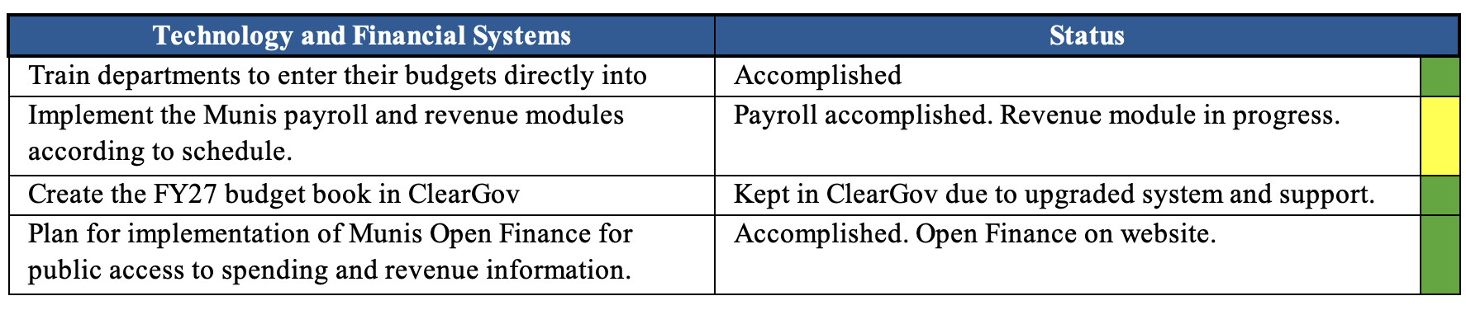
2025 Goals Status

Slide 19
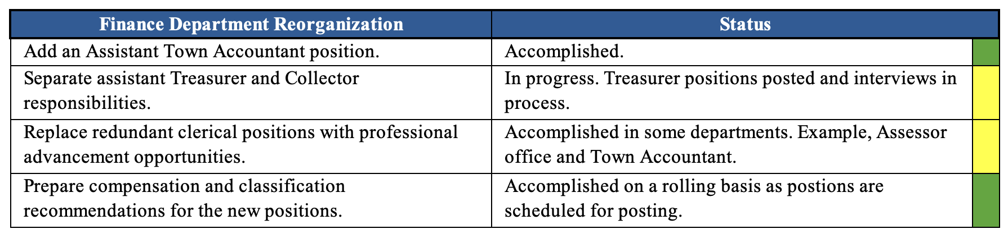
2025 Goals Status

Slide 20
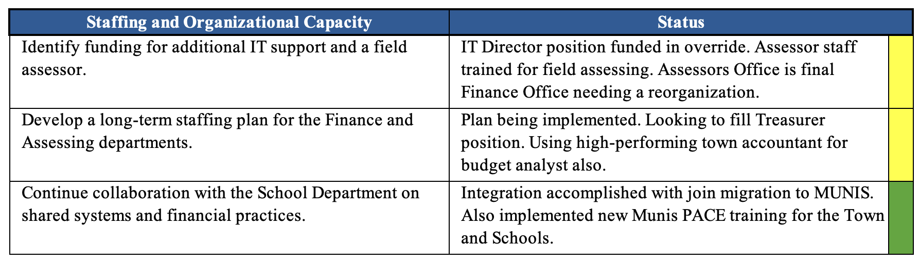
2025 Goals Status

Slide 21
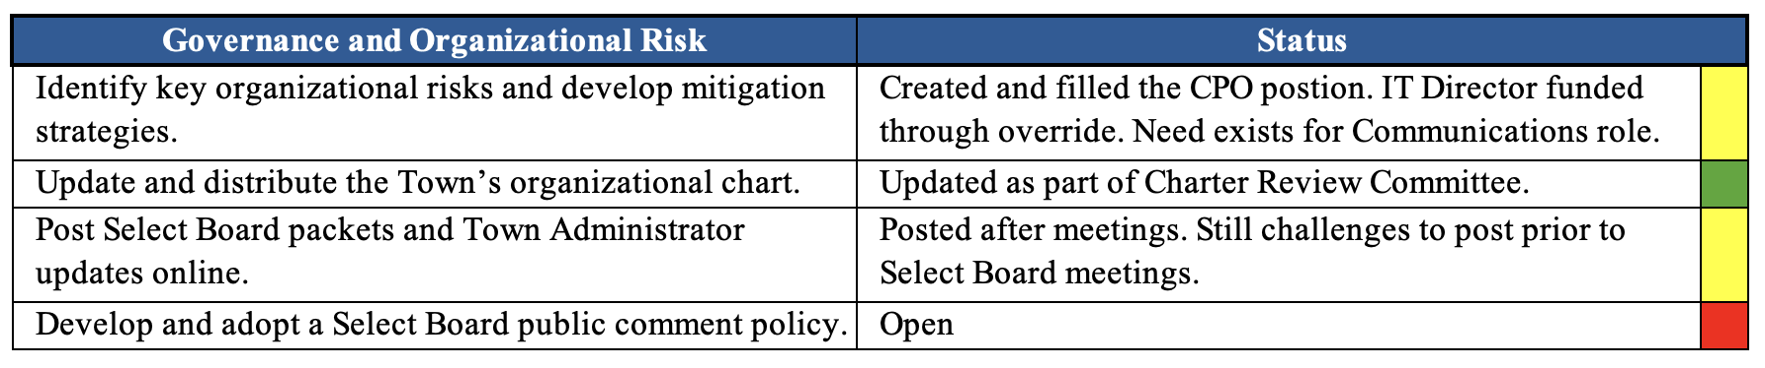
2025 Goals Status

Slide 22
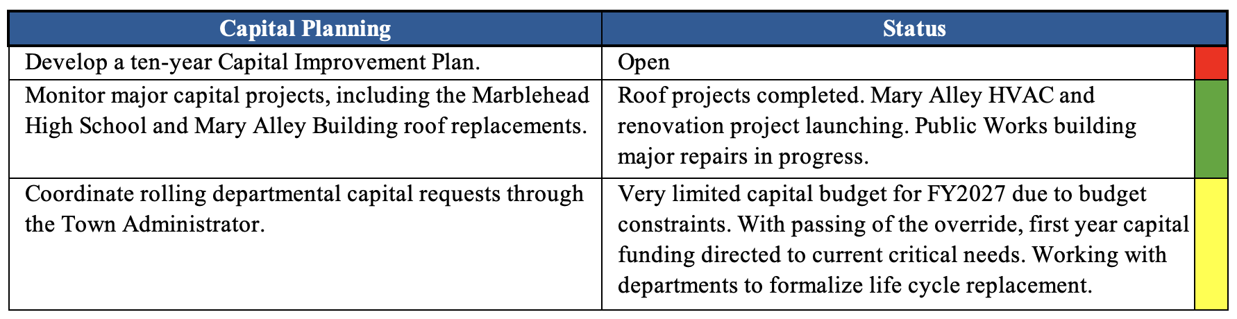
2025 Goals Status

Slide 24
2026-2027 Retreat Goals
Setting the Goals

Slide 25
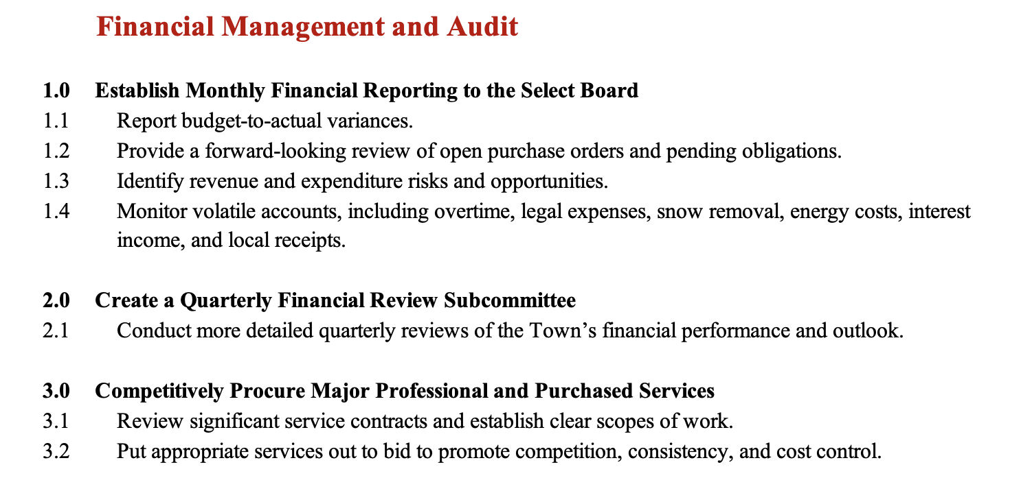
2026-2027 Proposed Goals

Slide 26
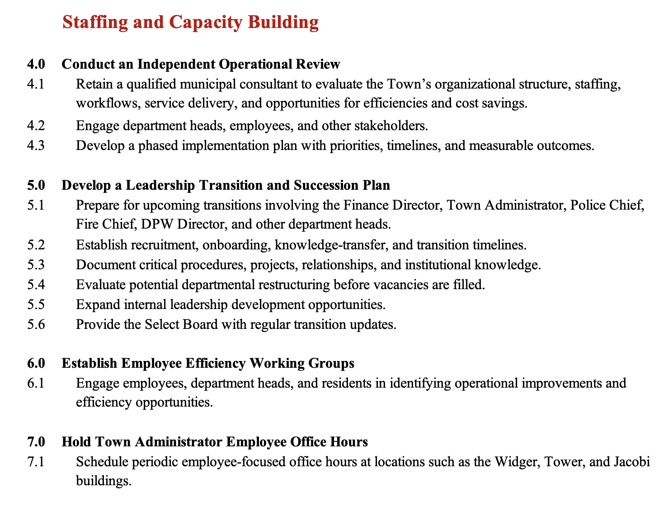
2026-2027 Proposed Goals

Slide 27
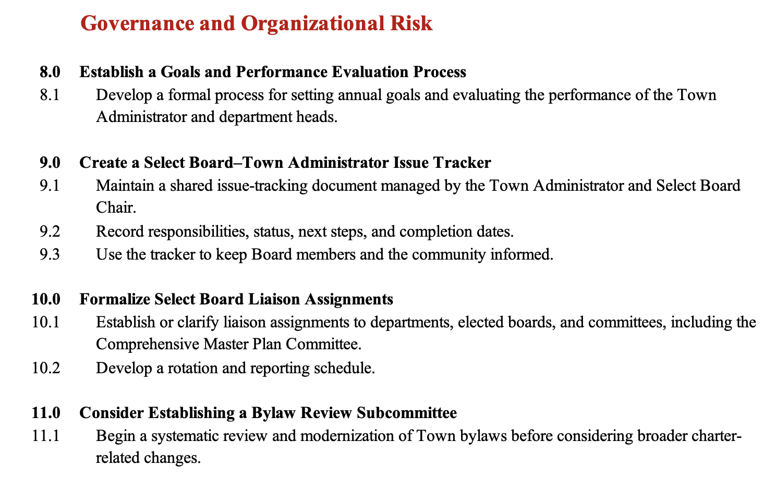
2026-2027 Proposed Goals

Slide 28
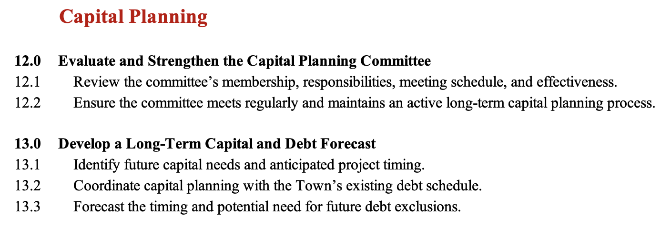
2026-2027 Proposed Goals

Slide 29
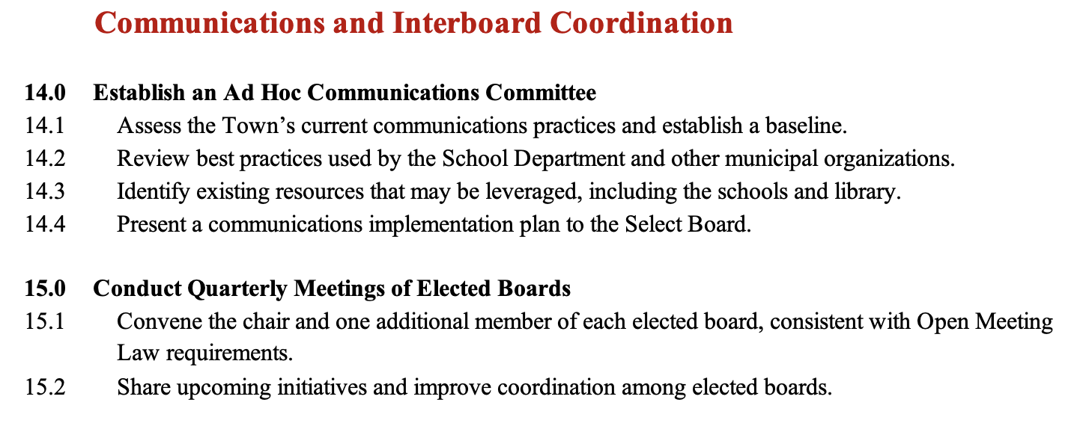
2026-2027 Proposed Goals

Slide 30
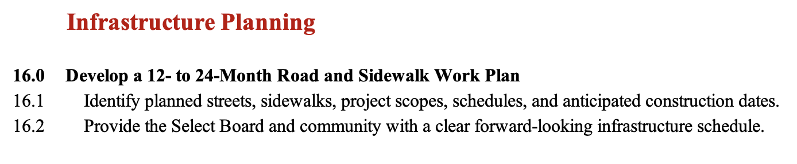
2026-2027 Proposed Goals

Slide 31
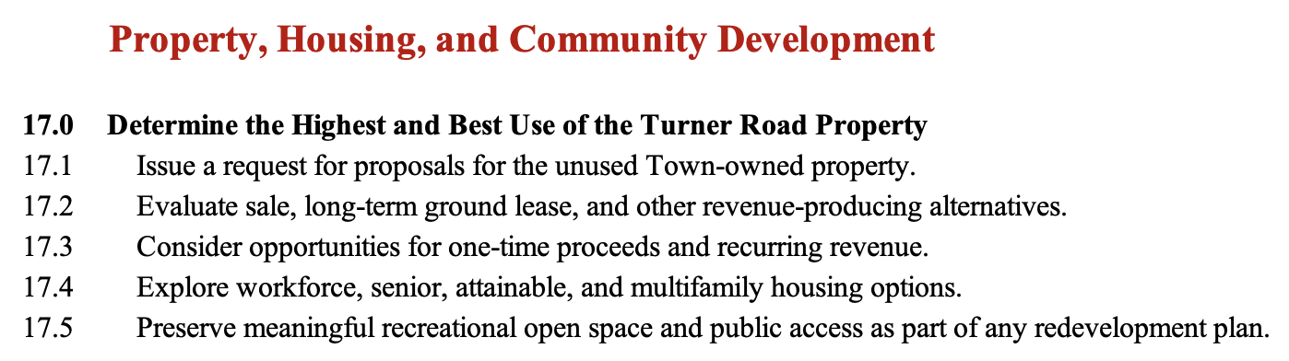
2026-2027 Proposed Goals

