Slide 1
Know Your Rights

Slide 2
Quick Overview of Immigration Enforcement

Slide 3
The Immigration System:
Department of Homeland Security
Immigration & Customs Enforcement
Customs & Border Protection
U.S. Citizenship & Immigration Services
Immigration Police / Enforcement, Detention & Deportation, representing the DHS in immigration proceedings
Enforcement at the border and within 100 miles of the border, checkpoints, and ports of entries
Adjudicates petitions for immigration benefits (asylum, green cards, citizenship, special visas)

Slide 4

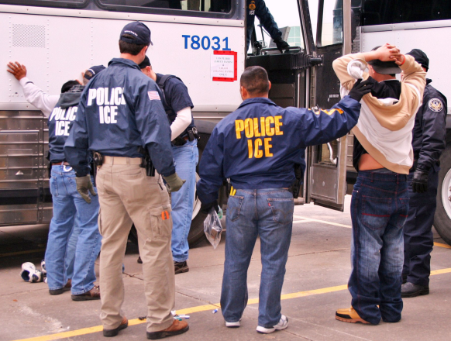
How People May Come into Contact with Immigration Enforcement
Contact with the criminal system
Applying for a benefit at USCIS, while having a removal order or criminal charge
Green card holders returning from travel
Raids & targeted enforcement
Other limited circumstances

Slide 5
Reasons for Deportation
Lack of lawful status
Sometimes, relatively minor and non-violent offenses can lead to mandatory deportation even for green card holders!
Criminal grounds, including:
- Nearly all drug convictions
- Some domestic violence, violation of protection order
- Some theft, fraud, and much more!
Immigration violations / Fraud
Security related grounds (gang involvement, terrorism)

Slide 6
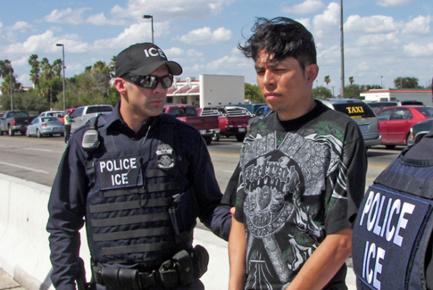
Who is at Risk of Deportation?
Anyone who is not a U.S. citizen can be vulnerable if they fall under a ground of deportation such as criminal charges or a prior order of deportation.
  Unauthorized / Undocumented immigrants
  People with asylum or refugee status or some other form of protection
  Lawful permanent residents (green card holders)
  Non-immigrants (visitors, students, etc.)

Slide 7
Know Your Rights
in Interactions with Immigration Enforcement

Slide 8

Basic Rights
Everyone living in the U.S. has certain basic rights under the U.S. Constitution, regardless of immigration status
It is important to assert these rights and protect our basic rights

Slide 9
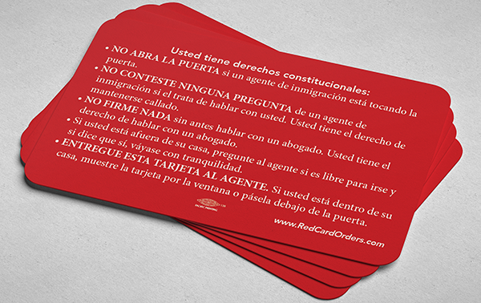
Rights Card
https://www.ilrc.org/red-cards
Multilingual Infographic for Using Rights Card
Asserting the right to remain silent can be difficult.
It’s helpful for people to have a rights card in their wallets that they can pull out and give to immigration agents or police.

Slide 10

If Immigration Comes to Your Home...
Do not immediately open the door:
Legally, you do not need to open the door unless the officer provides you with a warrant signed by a judge.
Ask officers to identify themselves (agency, name, ID)
Ask if they have a warrant signed by a judge
Slide a “Know Your Rights” card under the door
You have the right to remain silent and to an attorney. If you choose to invoke that, state to officers “I request my right to silence and to an attorney.”
Call a US citizen friend or family or an attorney

Slide 11
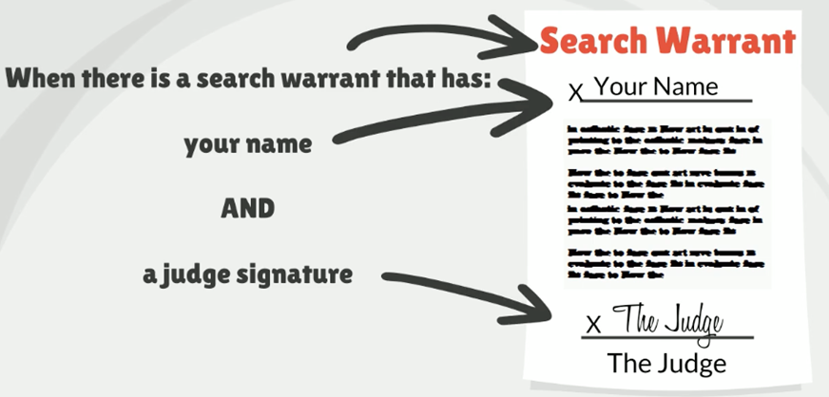
When can Law Enforcement enter my home?

Slide 12
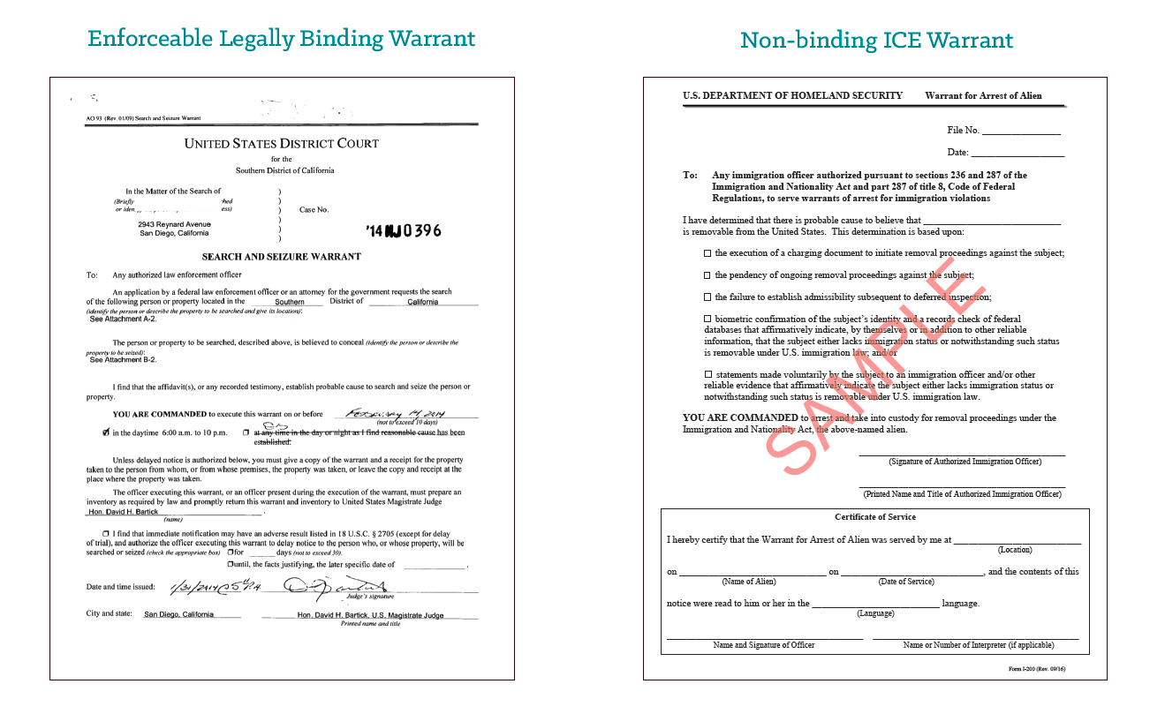
Warrants
Example of immigration warrant: does not give
Example of warrant signed by a judge immigration permission to enter the home

Slide 13
Driver’s Licenses
YOU MUST: drive only on a full driver’s license, not a permit
TO DRIVE on a permit, you must have someone in the car who has:
Been driving for 1 year
2) Over the age of 21
3) Sitting next to the driver

Slide 14
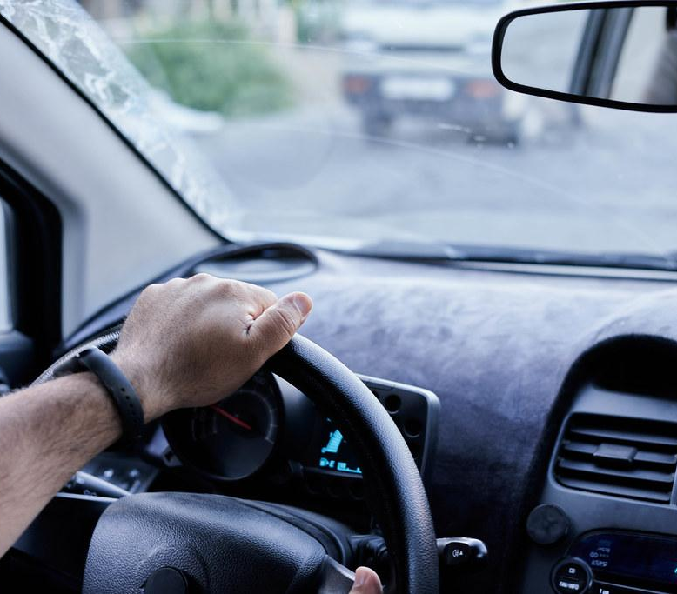
If You Are Stopped When Driving…
If you live in Massachusetts you are eligible to get a driver’s license regardless of immigration status!
Stay in the car. Place your hands on the steering wheel so the officer can see them.
You do not need to answer any questions but driver must provide name and address. Show your KYR card.
Police can search your car if they have probable cause to believe you have been involved in a crime
  STATE CLEARLY THAT YOU DO NOT CONSENT TO THE SEARCH
Do not provide false documents

Slide 15

If Immigration or Police Stops You in Public…
Stay calm - Do not run or resist arrest!
Ask if you are under arrest or free to leave.
Remain silent and say you want to speak to an attorney.
You have the right not to be fingerprinted unless you’re being arrested.
Police can search you if they have a reasonable suspicion that you are armed and dangerous.
If you have valid immigration documents and are over the age of 18, the law requires you to carry those documents on you.
You have the right to an attorney. Ask to call a lawyer.
  Never provide false documents!

Slide 16
How to Be Prepared
Know your rights in case an officer asks you questions or comes to your home.
Memorize phone numbers for your family members and/or an attorney/organization that you trust. You might only be able to make one phone call while detained!
Think of a U.S. citizen or someone with immigration status that you trust who can pay bond if you are granted one by an immigration judge.

Slide 17

Arrest and Detention
If you are arrested or detained, DO NOT:
  Sign anything or take “voluntary departure” without the guidance of a lawyer
  Rely on immigration agents to provide you with information about your rights; ask a lawyer for facts.
You have a right to:
  Remain silent.
  Call a lawyer or family member
  Be visited in detention by a lawyer
  Contact your consulate
You can use the online detainee locator to find someone who has been detained by immigration

Slide 18
Release on Bond
Immigration enforcement can choose to place individuals it is trying to deport in immigration detention
If detained, many individuals are able to request release on bond while their case is pending.
  You can request the immigration judge to review the bond decision
  It helps to show strong family and community ties
  Only someone who is a US citizen or has lawful immigration status should go to immigration to pay the bond

